Slide 1


BOOKFLOW
—Make the word flow out of the page
Yingjie Shi, Weiduo Wang, Rexy Miao, Rongqian Chen
2024.2.17

Slide 2
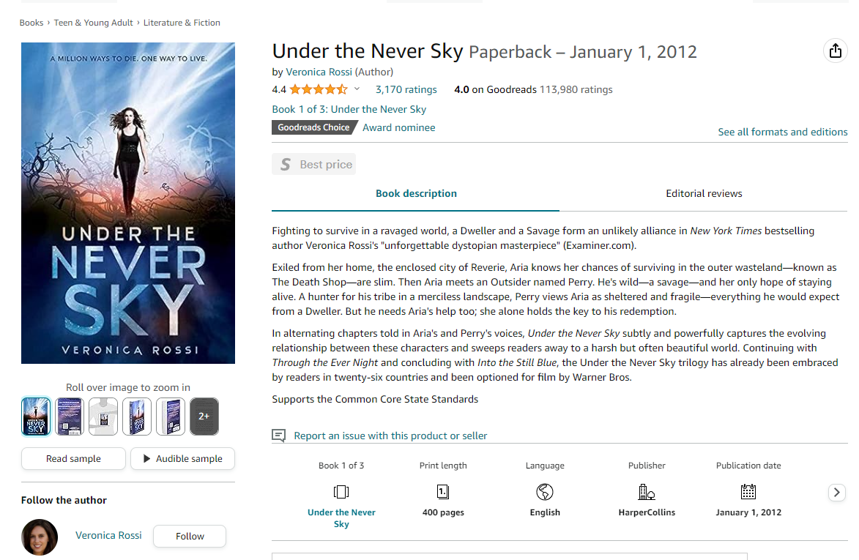
Book: A ubiquitous presence in everyone’s life
How can we grasp their main deliverables in minutes? Or even in
Seconds?
We need more!

Slide 3
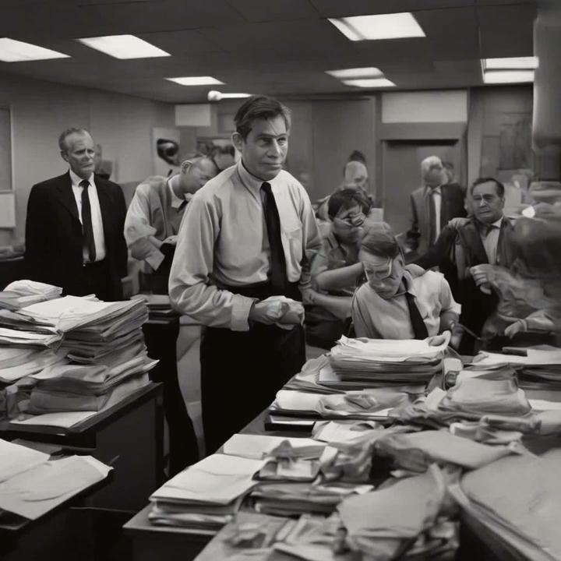
BOOKFLOW : revolutionize the rule of reading
The Jazz Loft Project: Photographs and Tapes of W. Eugene Smith from 821 Sixth Avenue, 1957–1965
In 1957, Eugene Smith walked away from his longtime job at Life and the home he shared with his wife and four children to move into a dilapidated, five-story loft building at 821 Sixth Avenue in New York City’s wholesale flower district. The loft was the late-night haunt of musicians, including some of the biggest names in jazz—Charles Mingus, Zoot Sims, Bill Evans, and Thelonious Monk among them. Here, from 1957 to 1965, he made nearly 40,000 photographs and approximately 4,000 hours of recordings of musicians. Smith found solace in the chaotic, somnambulistic world of the loft and its artists, and he turned his documentary impulses away from work on his major Pittsburg photo essay and toward his new surroundings.

Slide 4

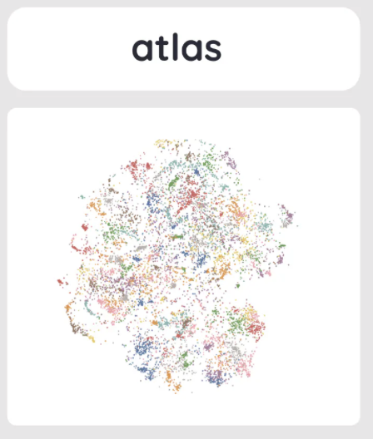





How did we achieve it?
Choice of YOUR favorite book genre
Video & Music
AI generated
Text
Book Abstract
AI music
Scene Generation
AI image
AI video

Slide 5
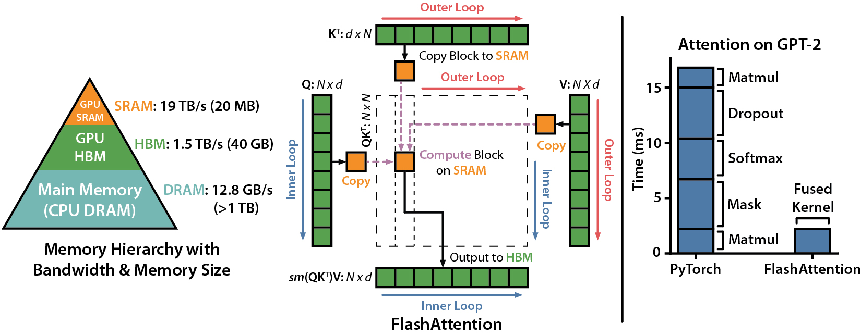
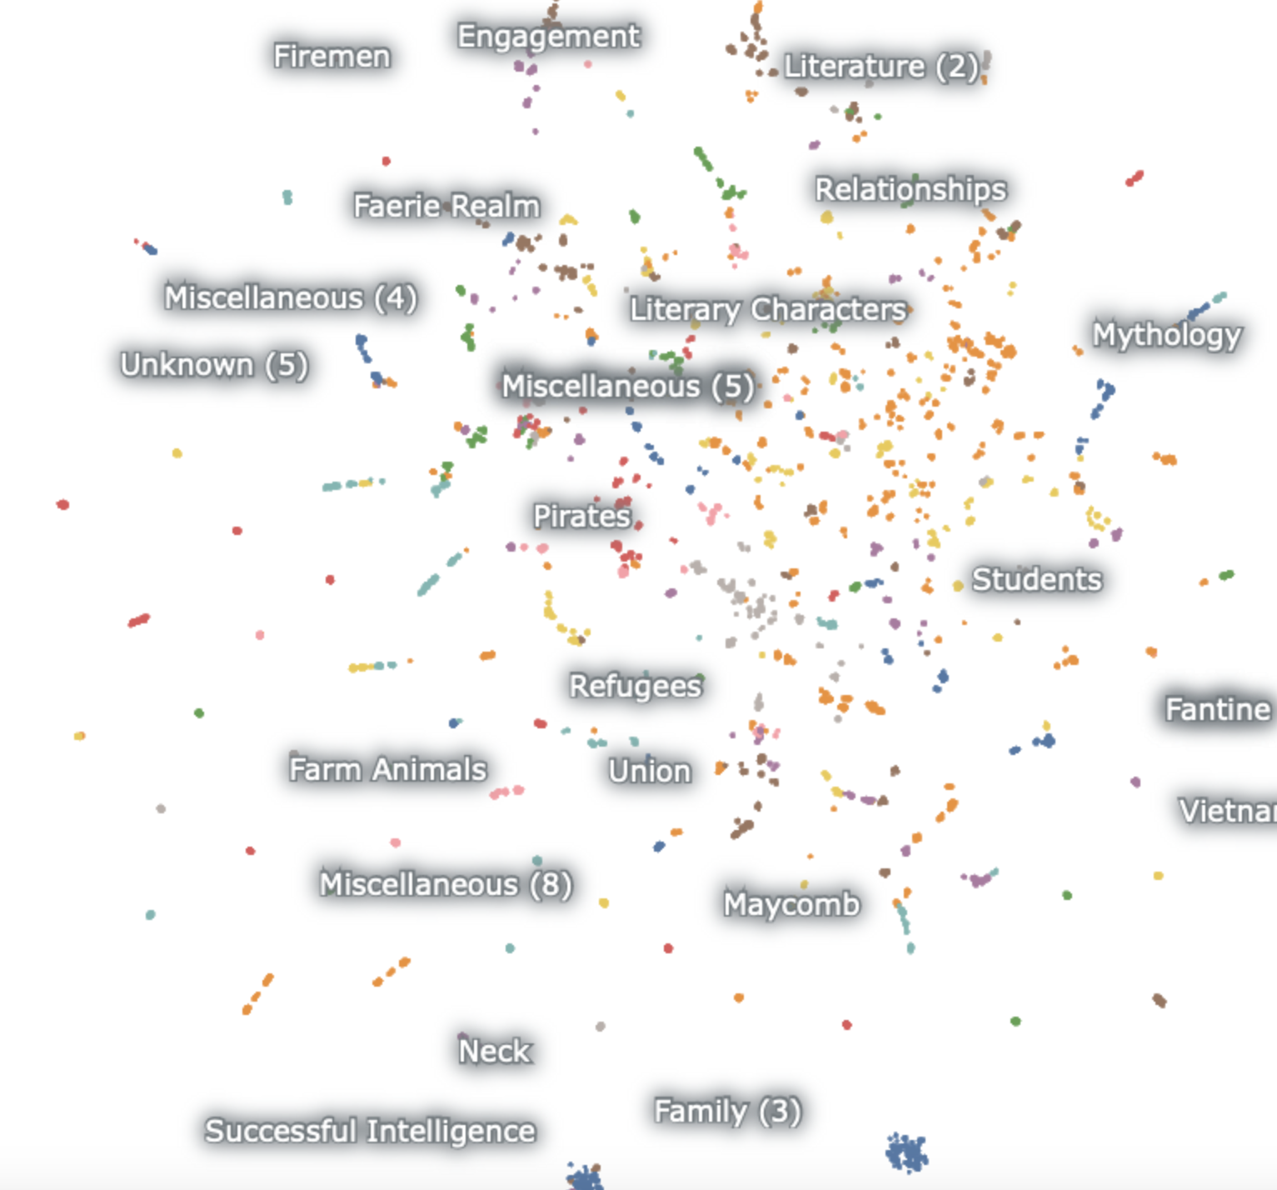
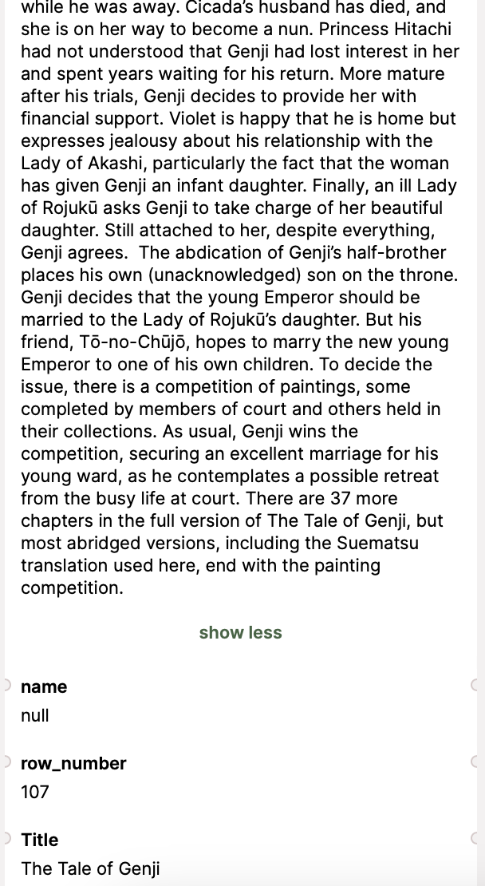
DeepScatter - map out your reading taste

Slide 6
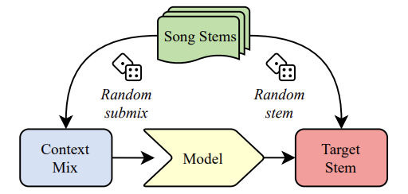

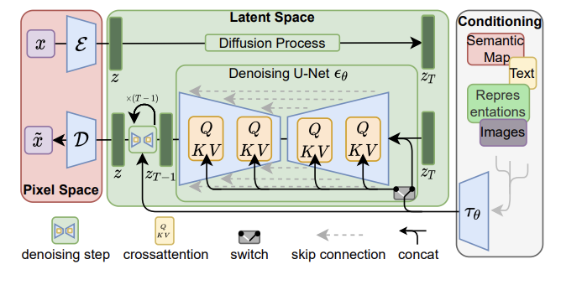
Outperform Sora

Slide 7
One more thing…

Slide 8
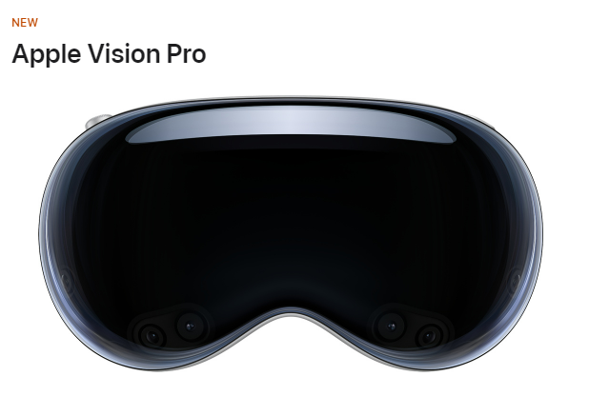



Unparalleled flexibility and customization, allowing users to tailor the visual representation to their preferences while maintaining the integrity of the source material.
Whether it's a classic novel, a contemporary short story, or original content, the program seamlessly transforms text into a cinematic masterpiece, enriching the storytelling experience for audiences worldwide.de.

Slide 9
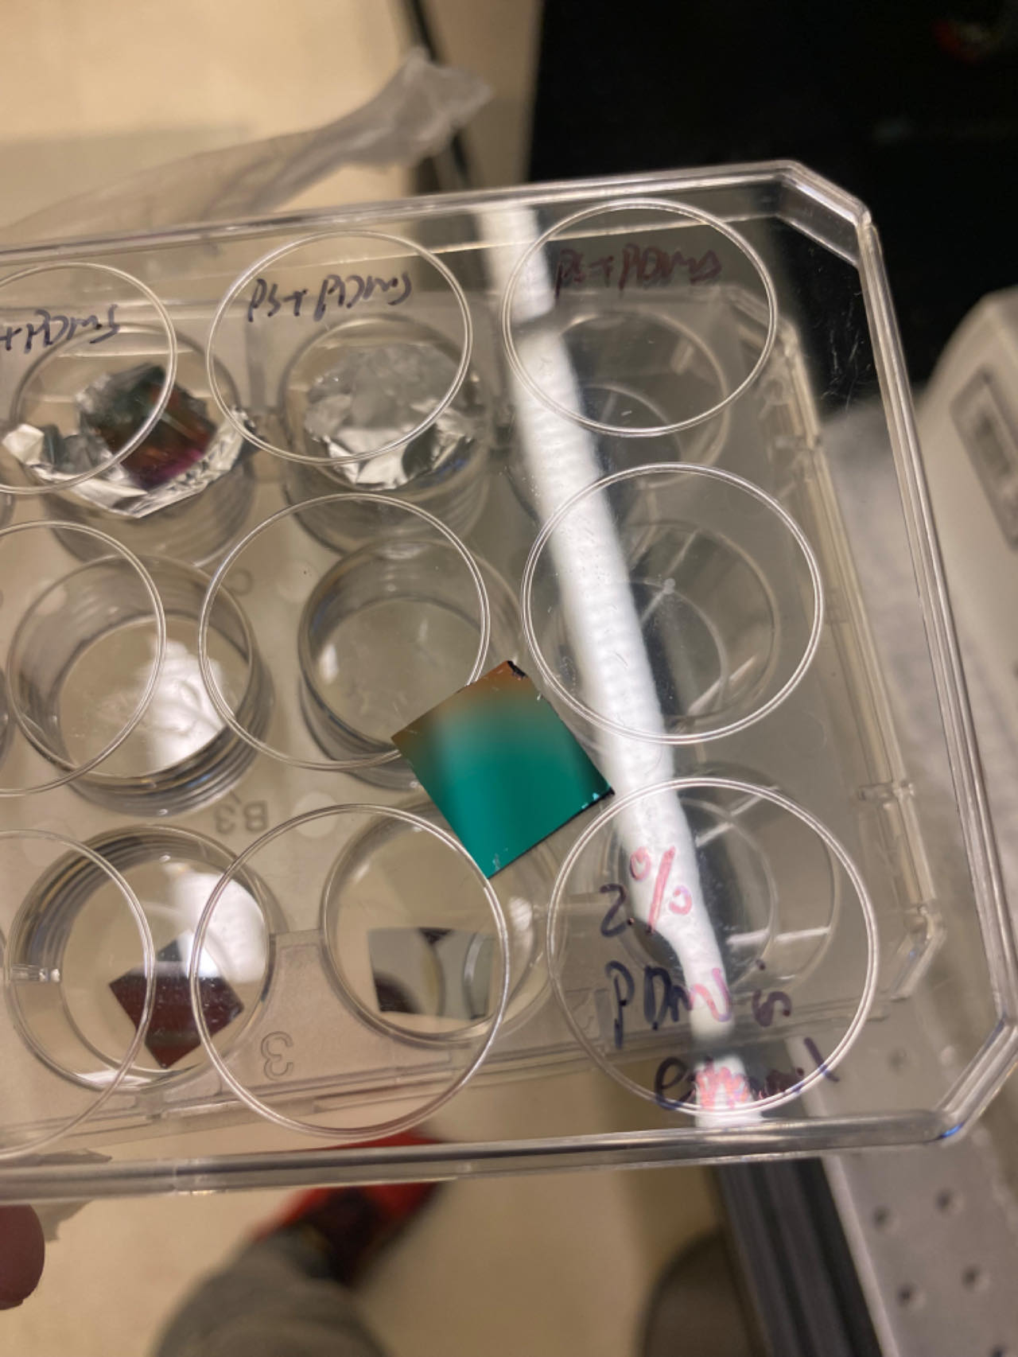
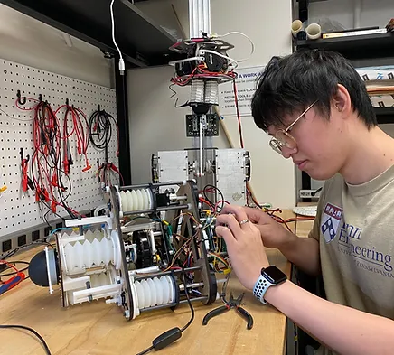
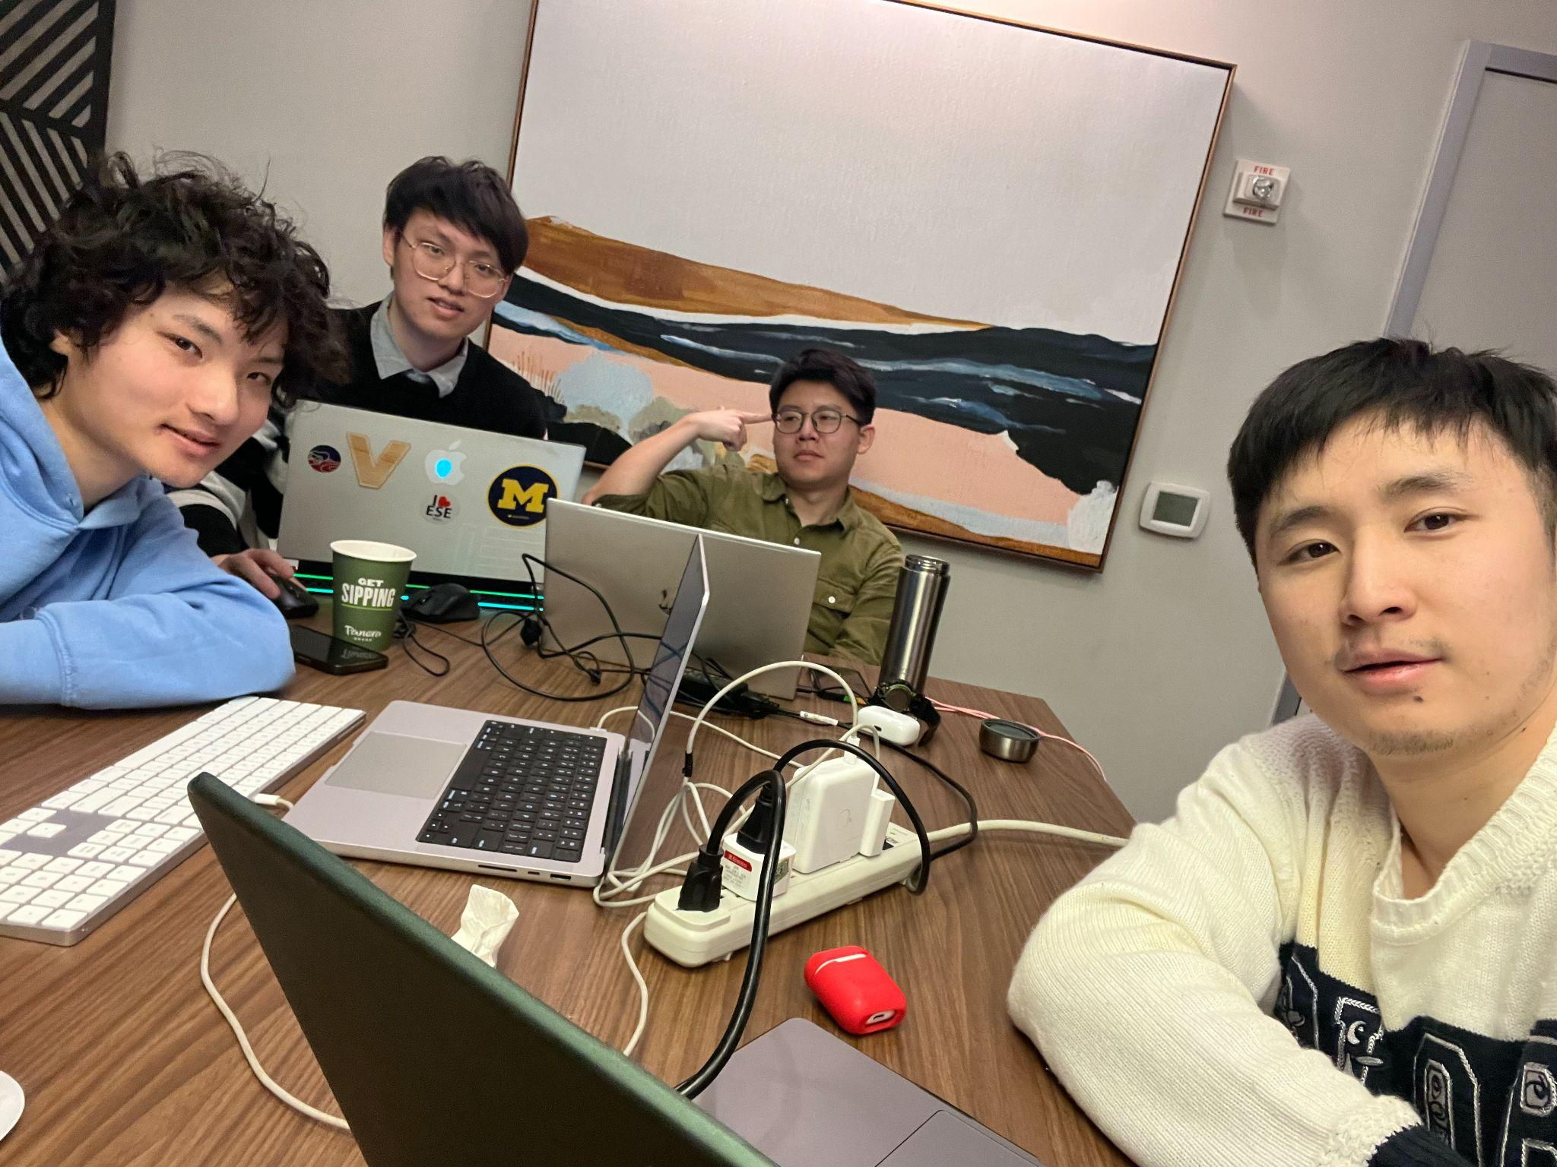
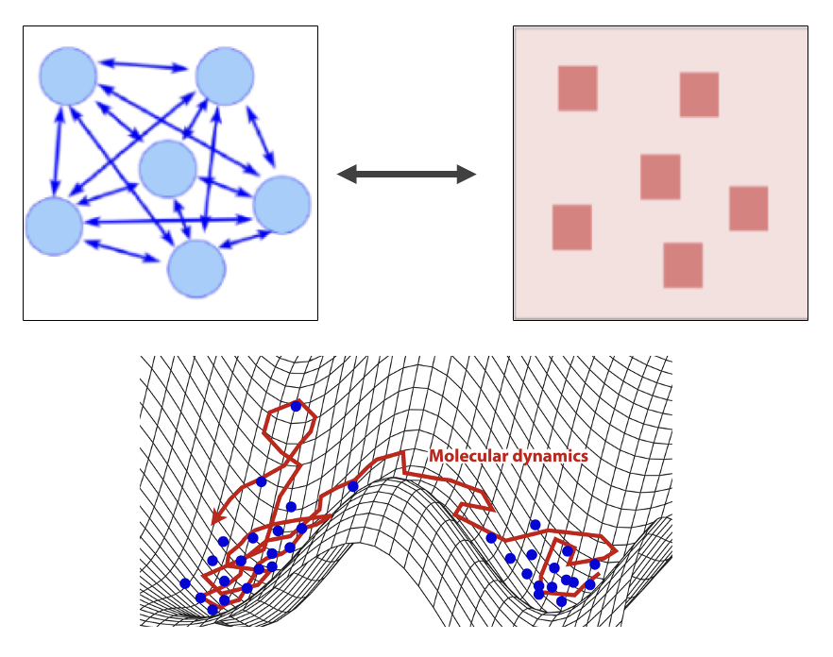
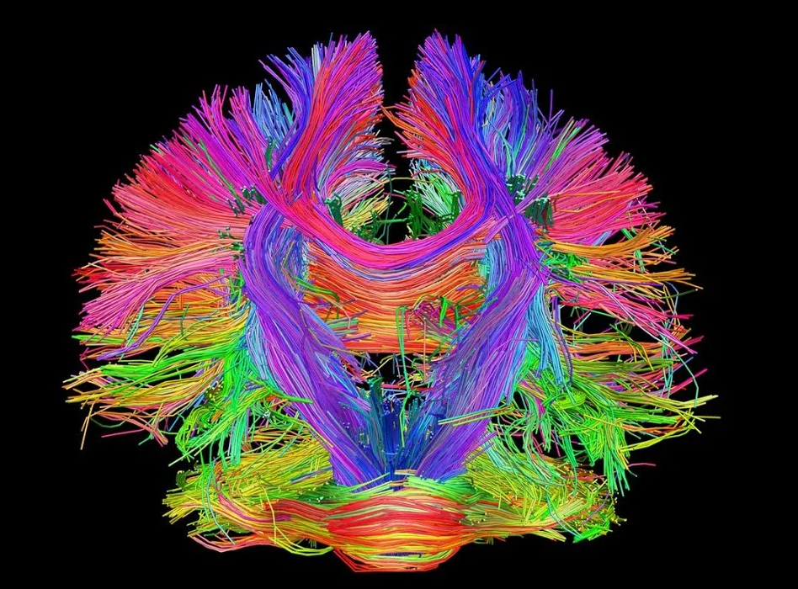

Thanks!
Weiduo Wang
Rongqian Chen
Hackers!
(26 hours)
Bagels+Coffee
Yingjie Shi
Rexy Miao
https://github.com/Rexmiao/DomusFlow.git

